Slide 1

Nashville Software School “Save the Tatas”
Presented by Adrianne Austin
Cohort da7 – Capstone

Slide 2
Inspiration for the project
My passion in helping others has led me to pursue a data analytics career within the healthcare industry.
Breast Cancer is in my family. We are fortunate that my cousin was able to have access to the medical treatment for her cancer, which now in now in remission.
My primary goal for my capstone is to continue to bring awareness in highlighting the importance of combating the disparities of breast cancer deaths amongst our female population.
Notes:
Her journey inspired me to complete this project. I realized that unlike my cousin, there are several females who were not as fortunate to beat their cancer due to several factors, such as the severity of the cancer, financial hurdles, or lack of access to adequate care.

Slide 3
Introduction: Breast Cancer Facts
According to the American Cancer Society(ACS):
For 2020 stats, ACS estimate about 287,850 women will be diagnosed with new cases of invasive breast cancer and approx. 43,250 women will die from breast cancer.
Chances of a woman getting breast cancer is about 13%.
Currently, the best way to find breast cancer for most women is through a mammogram.
The ACS recommends women aged 40 to 44 should get mammogram screenings at least one a year and annual screenings for women aged 45 to 49.
Notes:
Currently our best first line of defense in battling breast caner is through a mammogram.

Slide 4
Capstone Project
For this project, I want to examine the mortality rates of women in the state to see if there is a correlation between the high death rates, the number of available mammograph facilities and insurance.
For counties that have a higher death rate, how many mammograph facilities are available?
Correlation between number of facilities available per county and the mortality rate.
For the counties that have a higher death rate, how many of the females within those counties have insurance coverage?
Correlation between access to insurance coverage and the mortality rate.
My goal again of my capstone project is to highlight the importance of reducing breast cancer deaths amongst our female population.

Slide 5



Dataset & Analysis Tools
Death Rates by County - State Cancer Profile
The stats are produced are from a collaboration between the National Cancer Institute and Centers for Disease Control and Prevention.
Death rates by County during 2016-2020 timeframe.
https://statecancerprofiles.cancer.gov/
Insurance Coverage & Income
US Census Bureau – American Community Survey 5-Year Estimate 2016 – 2020
https://data.census.gov/
FDA Mammograph Facilities
https://www.accessdata.fda.gov/scripts/cdrh/cfdocs/cfMQSA/mqsa.cfm
Python
Excel

Slide 6
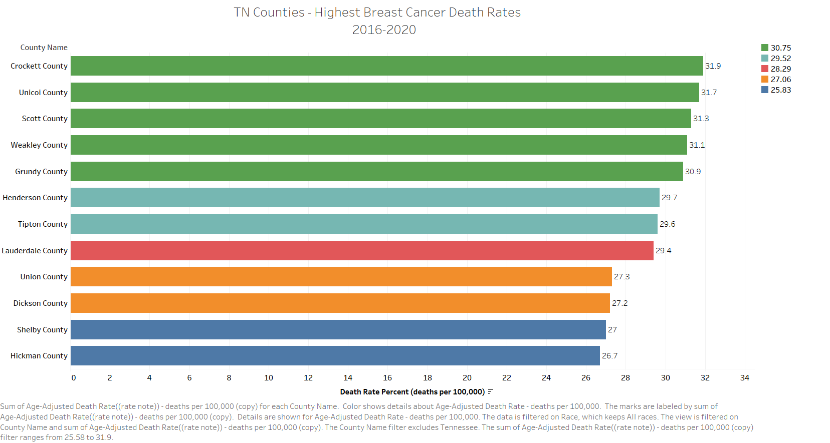

Slide 7
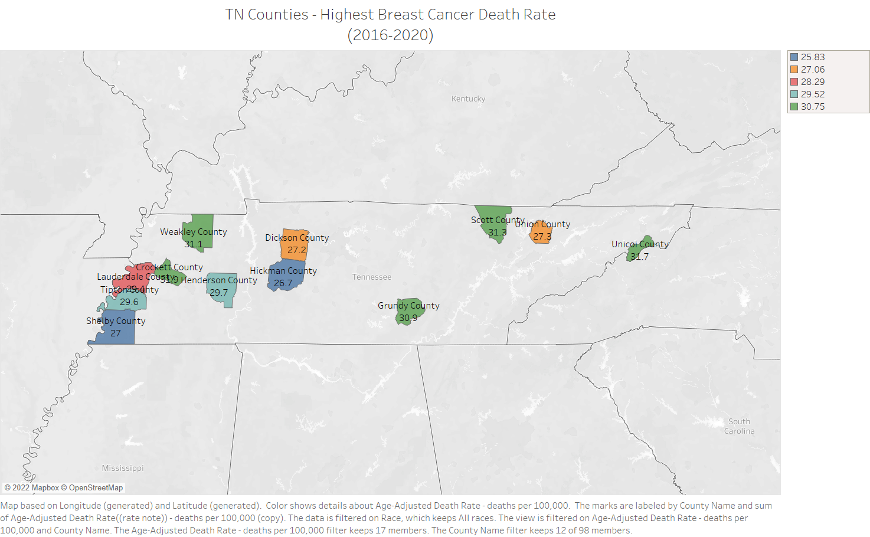

Slide 8
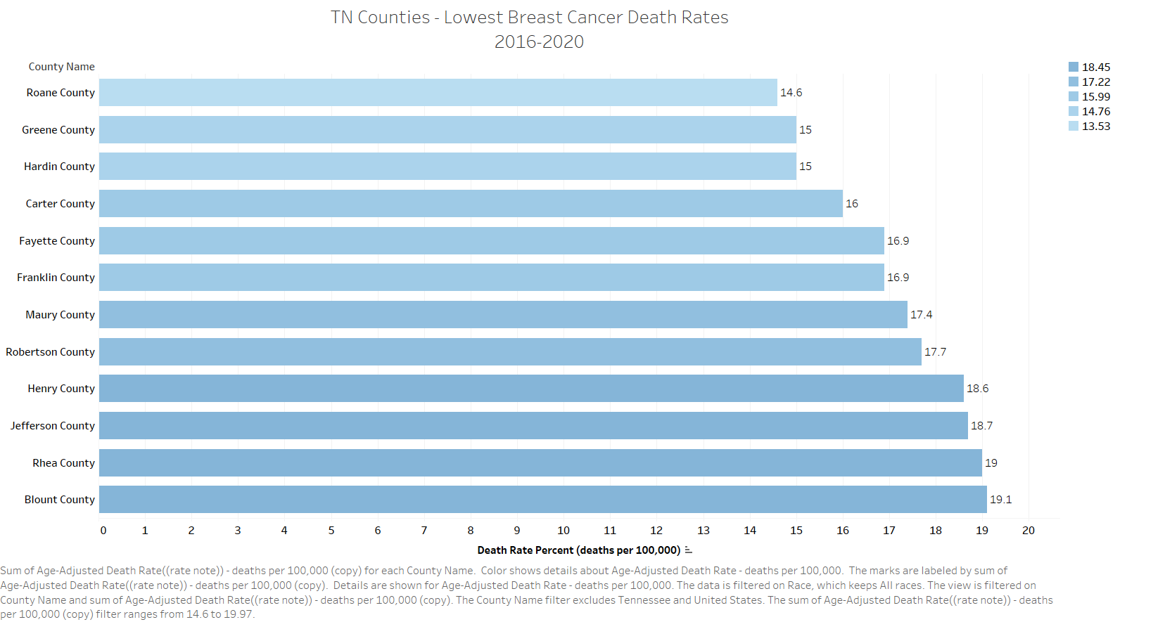

Slide 9
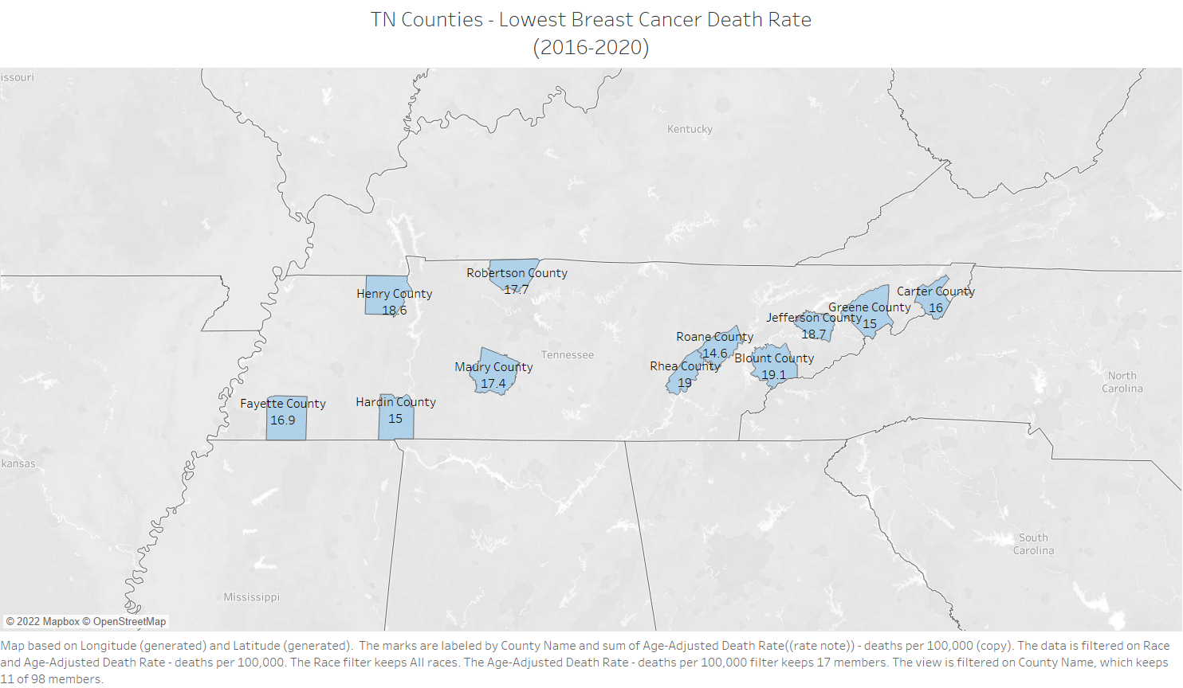

Slide 10
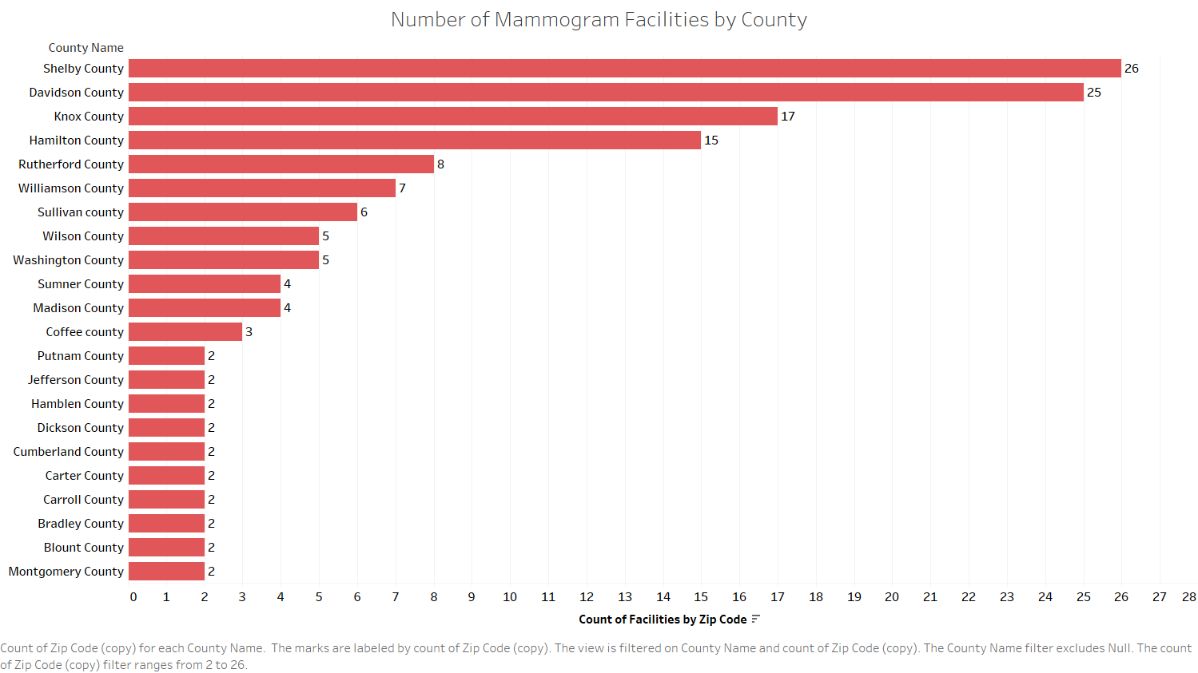
Notes:
There are 192 FDA approved mammogram facilities located in TN within 69 counties.

Slide 11
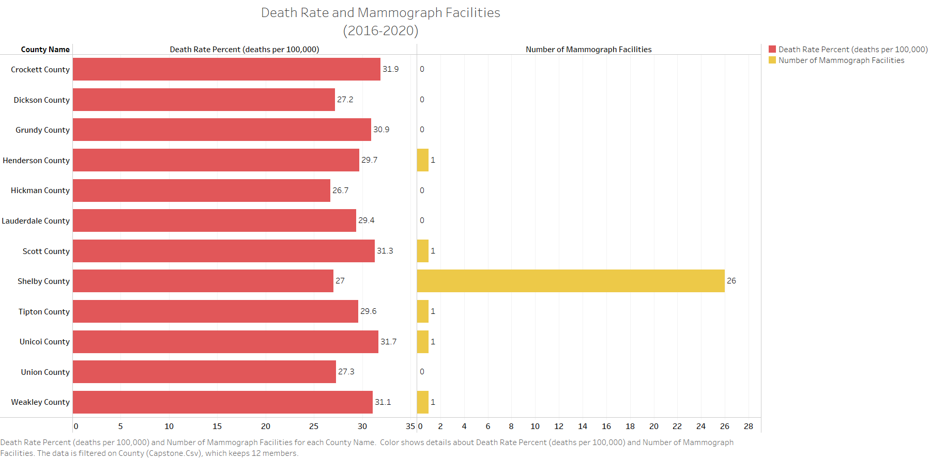
Notes:
Out of the 12 counties that have the highest mortality rate, only 6 counties have fewer than 1 facility, expect for Shelby County.

Slide 12
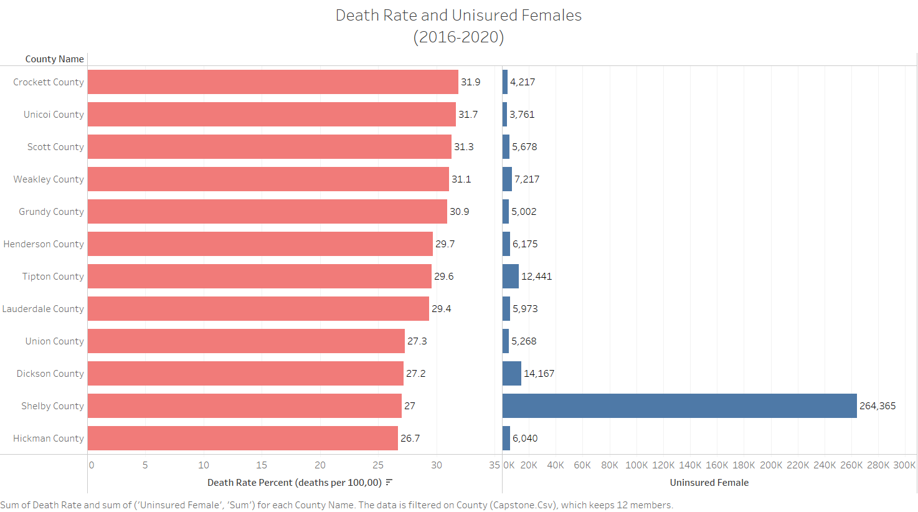

Slide 13
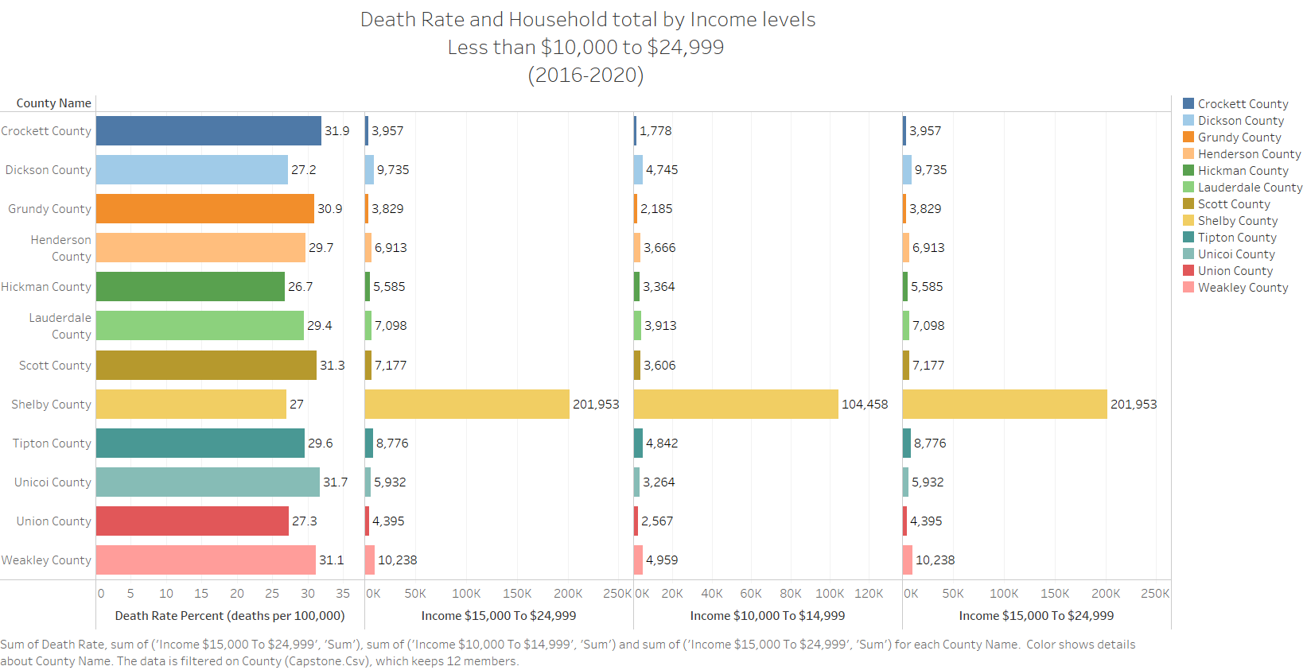
Notes:
In looking at the high numbers of the uninsured –I wanted to look at the financial aspect of the uninsured.

Slide 14
Analysis and Conclusion
First Question: Is there a correlation between the counties that have a higher death rate with the number of available mammograph facilities? If so, what is the correlation?
Yes, the counties that have a higher death rate have 1 or fewer than 2 mammograph facilities, except for Shelby County.
Second Question: Is there another factor, such as insurance that in play contributes to higher mortality rates within these counties?
Yes. According the Census Bureau – between 2016-2020 about 4,052,700 people were uninsured or didn’t have insurance coverage within Shelby County and out of that number about 264,365 were uninsured females.

Slide 15
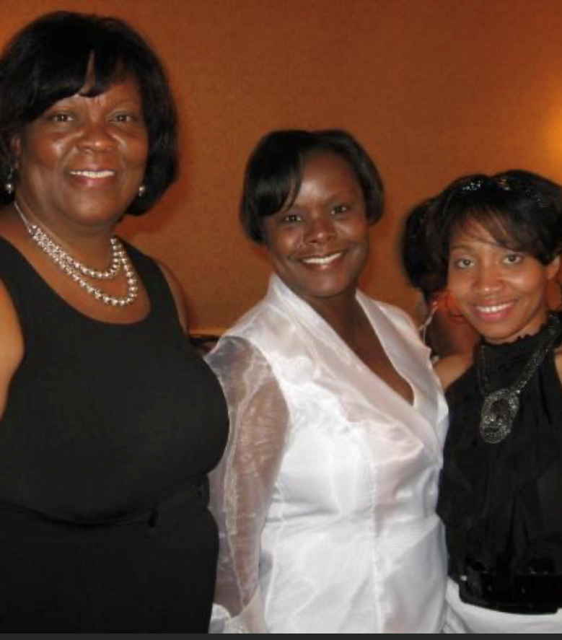


My 2nd Cousin - Deborah
Notes:
Want to provide a face behind my motivation for this project. I hope that my Capstone will continue the talks and push to dive down the breast caner mortality rates within the State.
TN has a mortality of 21.6 compared to the National (USA) rate of 19.6.

